Slide 1

Membership Platform
Club Admin Help
Version 08 – July 2021

Slide 2
CLUB ADMIN
EVENTS AND TEAMS
GENERAL ADMIN
Update your club profile
Take out club membership
Administer club members
Assign club roles
Add a club member
Bulk renew members
Set up a family
Enter events
Create a team
Create and submit crew lists
Make payments
Run reports
Documents
What do we mean by…?
FAQs
I still need help!
Submit a DBS Check

Slide 3
WHAT DO WE MEAN BY?
Some terms used on the digital platform are a little different to the way we might normally use them, so this is what it means by…..
Club Administrator
The person in your club responsible for the administration of this system. If you are reading this, it’s probably you.
Registered User
Someone who has registered on the BDA platform but not yet taken out membership, these people may be shown in your club
BDA Members
Someone who has registered on the BDA platform and paid for individual BDA membership
Club Members
Someone who has registered on the BDA platform and has been approved to add your club to their profile; they may not be BDA members
Club Affiliation
Your club’s BDA membership which provides your insurance and entry into the National League
Credential
A BDA coaching or helming certificate or other non-BDA qualifications such as first aid or powerboat licenses. Club welfare officer’s checks on a club member’s DBS status are also held as credentials
Team
A crew you enter in a race event, such as a mixed crew, an open crew or a second crew
Roster
A list of people in your team – what we would call a crew list

Slide 4
FREQUENTLY ASKED QUESTIONS
Why does a credential show as “Inactive Pending Conditions”?
All coaching and helming credentials require the holder to be a member of the BDA to ensure that insurance is provided. Additionally, coaches of Level 2 and above require a Club Welfare Officer DBS check. Without both, the credential will show as “Inactive Pending Conditions”.
Why can I not see a member in my club who I know is already a BDA member?
Members must explicitly consent to sharing their data with you as a Club Admin. They do this by logging into the system and then selecting a club. If they have not selected your club, you will not see them on your Club Members list. You can invite them to become a member of your club.
I share an email address with another member of my family; how does this work on the system?
You can share an email address with another member, however you will both need separate usernames so you can log in to the two accounts separately. Most members use their email address as their username, but this can be changed when a member registers or in their profile afterwards. If you want to administer the account on someone’s behalf, you can create a family, which will allow each member to see and change the details of everyone in that family.

Slide 5
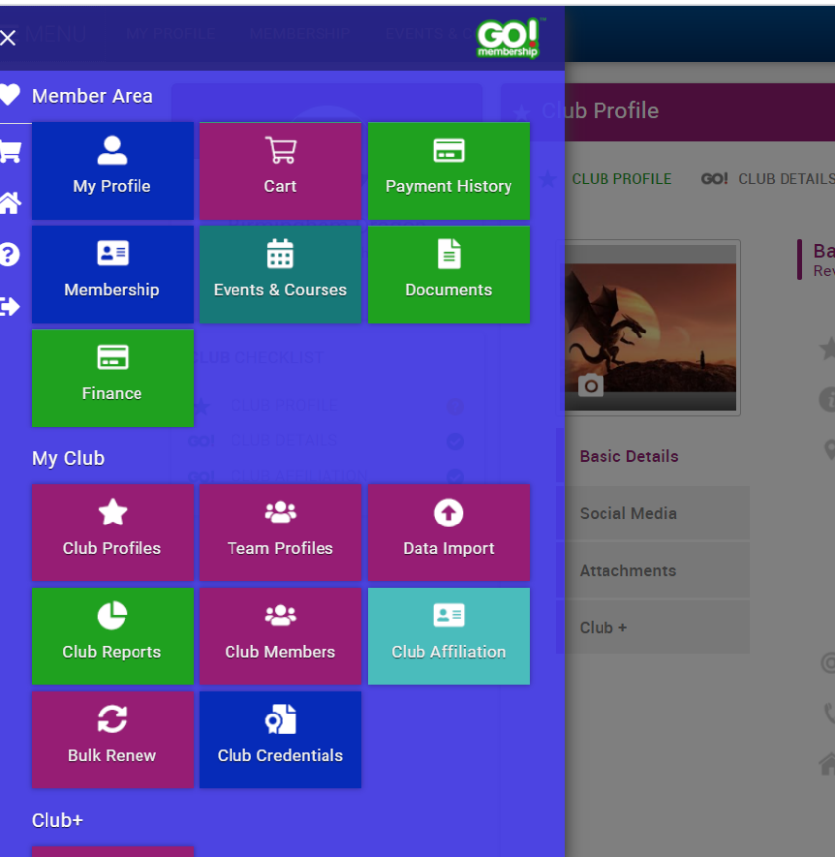
CLUB ADMIN MENU
CLUB ADMIN MENU
1
My Club menu
Club Admin Menu
When you are made a Club Admin for your club you will see the My Club section of the menu.
Club profiles, team profiles and club reports contain unique information. Information in the other tiles can be accessed through those three tiles as well.
1

Slide 6
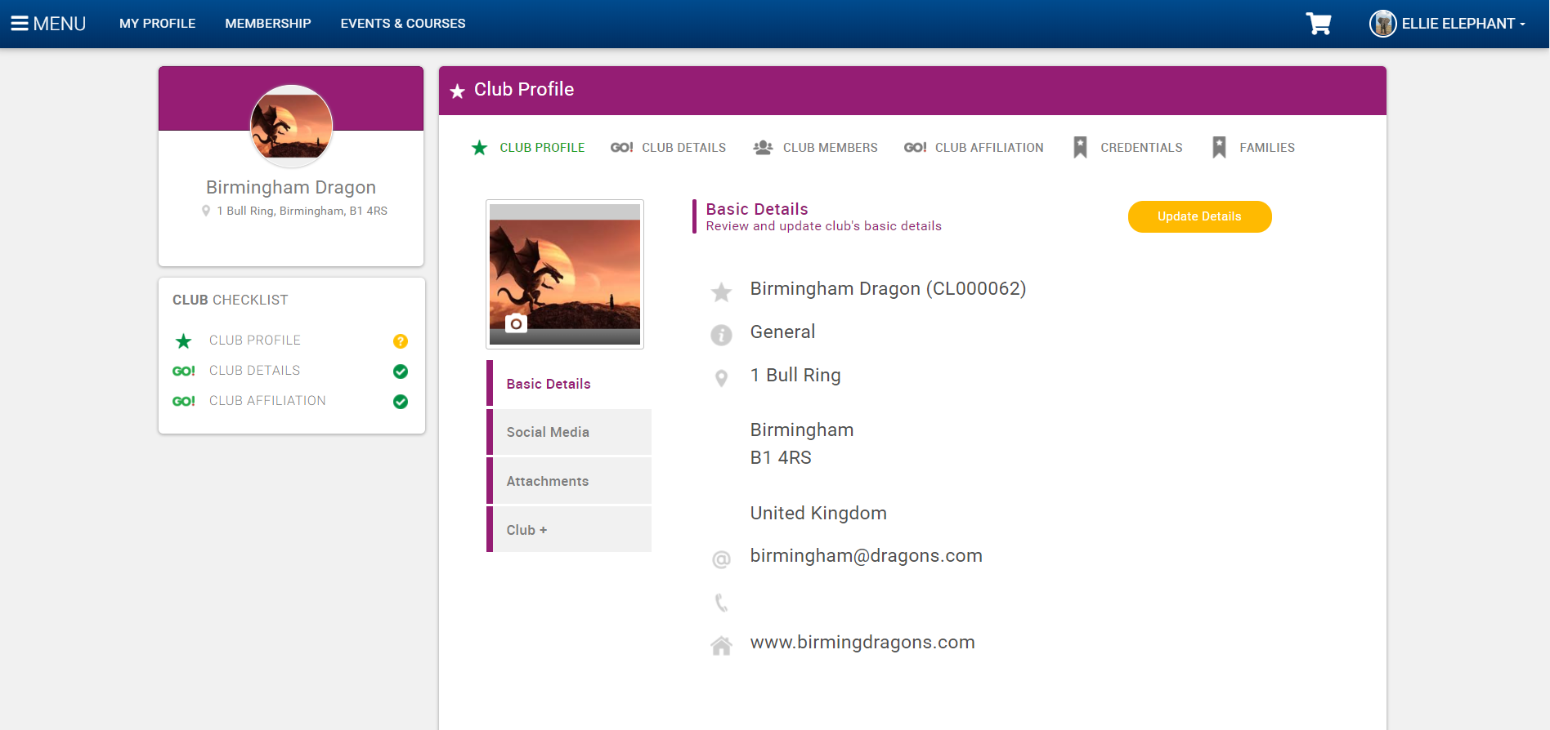
CLUB PROFILES
CLUB PROFILE
1
Main menu
1
3
2
Sub-menu
3
Change profile picture
4
Change profile information
2
4
Click here to update the Basic Details
Basic Details
Information here will be shown on the Club Finder on the public BDA site. The email address should be the one you want enquiries from the BDA site to be sent to.
Click Club Profiles to access this page

Slide 7
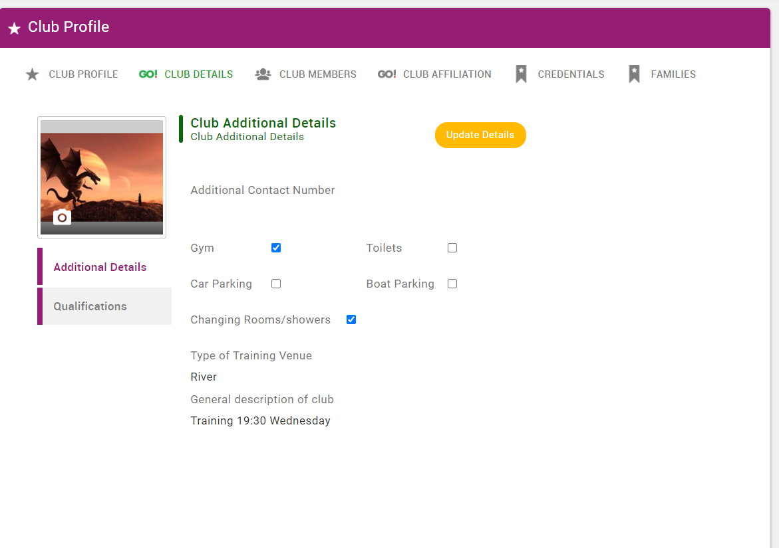
CLUB ADDITIONAL DETAILS
1
CLUB ADDITIONAL DETAILS
1
Click Club Details Menu
2
Click Additional Details Menu
Click here to update the Additional Details
2
Additional Details
Information here will be used by the BDA to understand the clubs better and to collect information that may be required to apply for grants, promote the sport, assess race or training venues and ensure proper governance. Please fill in as much as you can.
If you have any concerns over the use of this information, please talk to us.

Slide 8
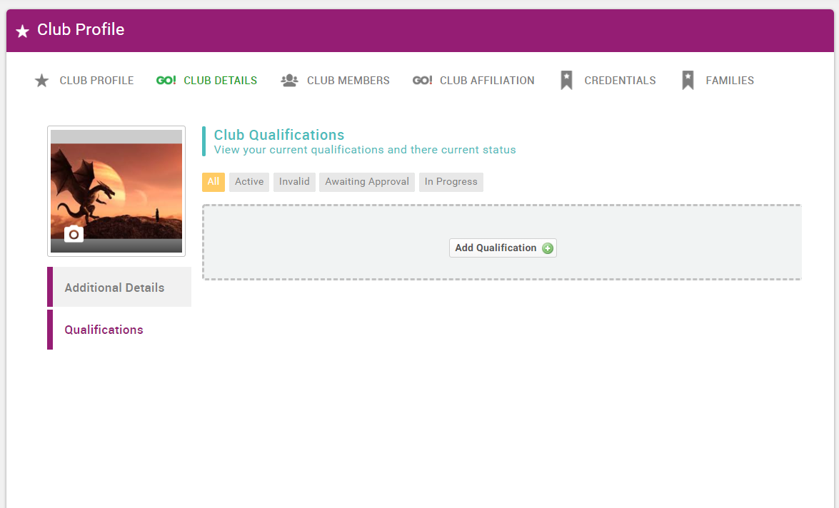
CLUB QUALIFICATIONS
1
CLUB QUALIFICATIONS
1
Club Details Menu
2
Qualifications
2
Club Qualification
Note this is a club level qualification not an individual qualification such as a coaching qualification
We are not currently using club qualifications, but may use them in the future

Slide 9
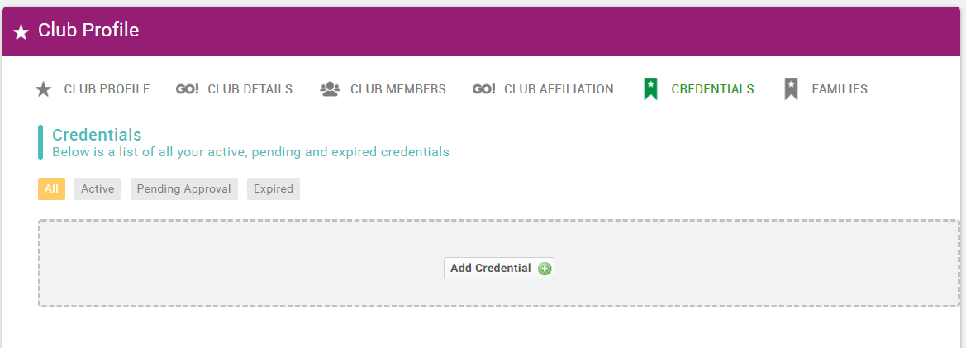
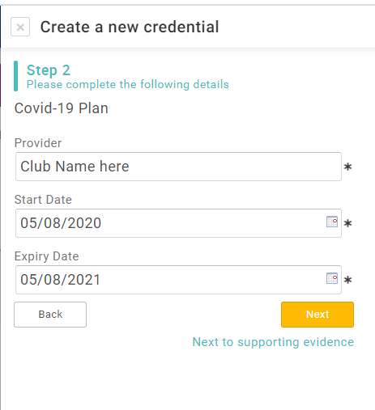
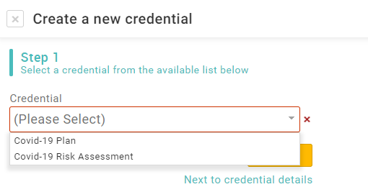
CLUB CREDENTIALS
1
CLUB CREDENTIALS
1
Credentials Menu
2
Select the credential
3
Fill in the details (for Covid-19 credentials use your club name as the provider) and add an expiry date in a year’s time
2
Club Credential
Note this is a club level credential not an individual credential such as a DBS certificate

Slide 10
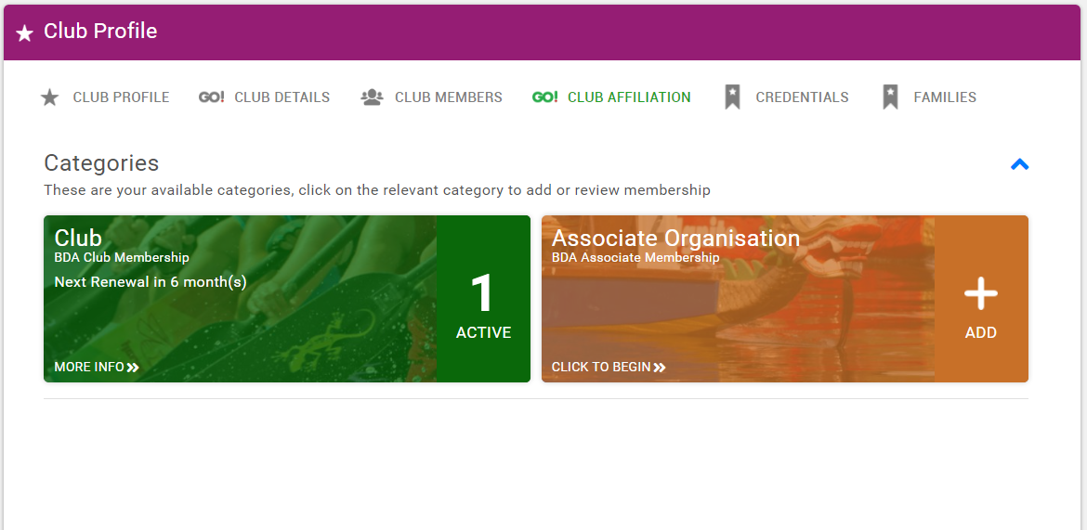
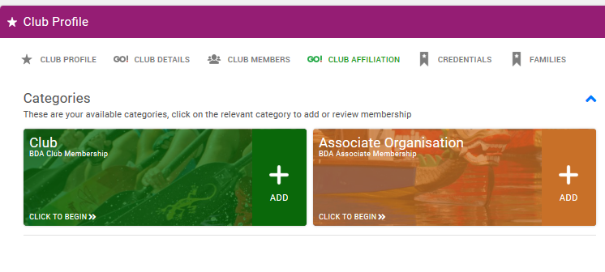
CLUB AFFILIATION
1
CLUB AFFILIATIONS
1
Club Affiliation Menu
2
Membership Paid
2
3
Membership not Paid
4
Click to take out membership
Club Affiliation
This is where you will see your club membership of the BDA. You will be able to renew the membership 30 days before it expires. See the next slide for the types of membership available.
Associate Organisation Affiliation
This is for watersports centres or similar organisations that want to affiliate to the BDA.
3

Slide 11
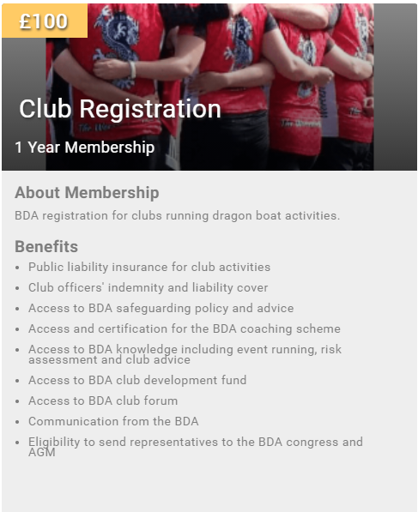
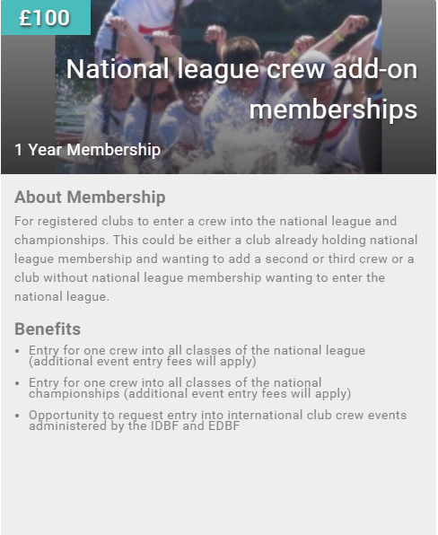
CLUB MEMBERSHIP TYPES

Slide 12
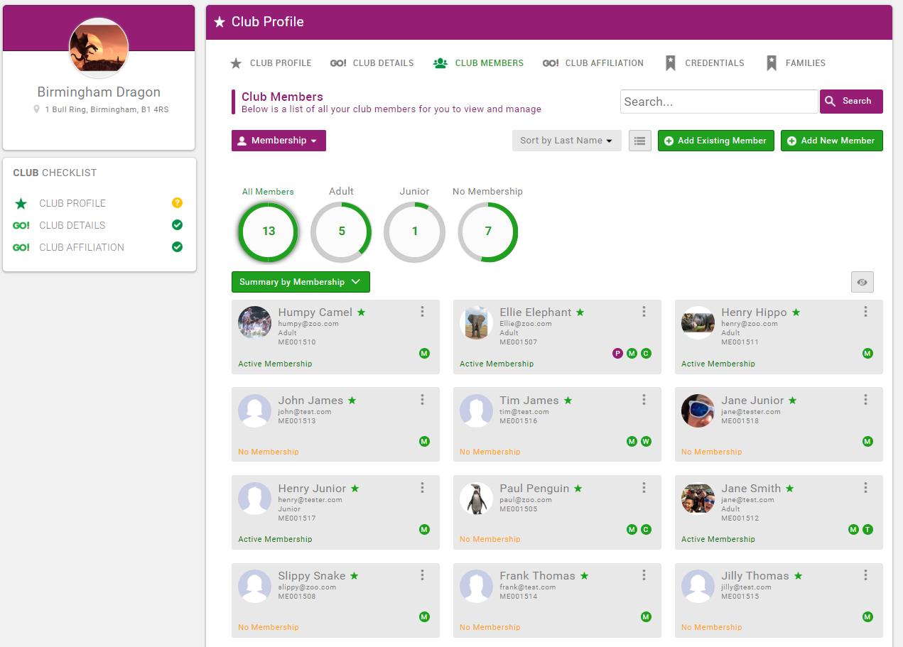
CLUB MEMBERS OVERVIEW
1
CLUB MEMBERS
1
Club Members Page
2
Click to filter
4
2
List of club members and details
3
4
Add an existing or new registered
user to the club
Club Members
This is where most of your club admin will be done from. For your members you can:-
Change their details
See their BDA membership status
Buy and renew BDA membership
Ask them to join your club
Remove from your club
Add a qualification
Add a credential
Assign a club role such as treasurer
You can also ask existing BDA members to join your club and add new members to your club if they have not yet registered on the system. If you invite a BDA member to join your club they will be sent an email and asked to confirm.
3
Active Membership – holds current BDA membership
Inactive – membership has expired more than two months ago
No Membership – has never held membership
Lapsed – has had membership, but this has run out

Slide 13
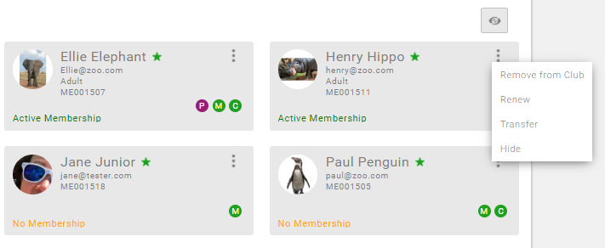
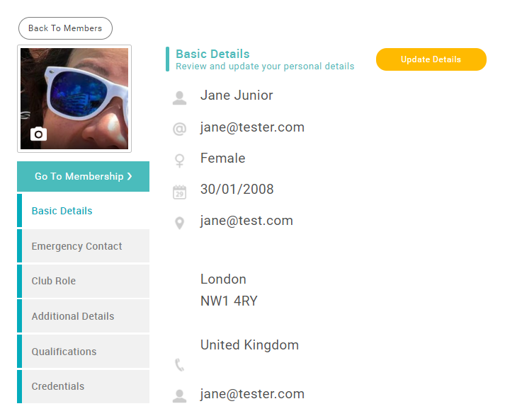
CLUB MEMBERS’ DETAILS
2
CLUB MEMBERS’ DETAILS
4
Click to edit a member’s details. This is the same as for your own member profile including adding credentials and qualifications and taking out a membership for them.
1
2
BDA Membership Status
3
3
Club Role (change)
P – this is the member’s primary club
M – member
C – club admin
T – treasurer etc
Hover over letter to see details
1
Click here to take out a BDA Membership for a member
4
Click to access Remove, Renew, Transfer, Hide.
A Club Admin is not required to transfer a member, they can choose to do it themselves or to join multiple clubs so if you are “borrowing” or “lending” a member for a race it is better for them just to temporarily add another club themselves.
Click here to update the Member’s Details

Slide 14
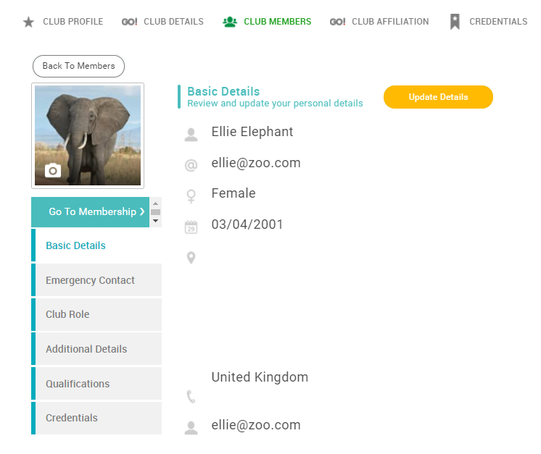
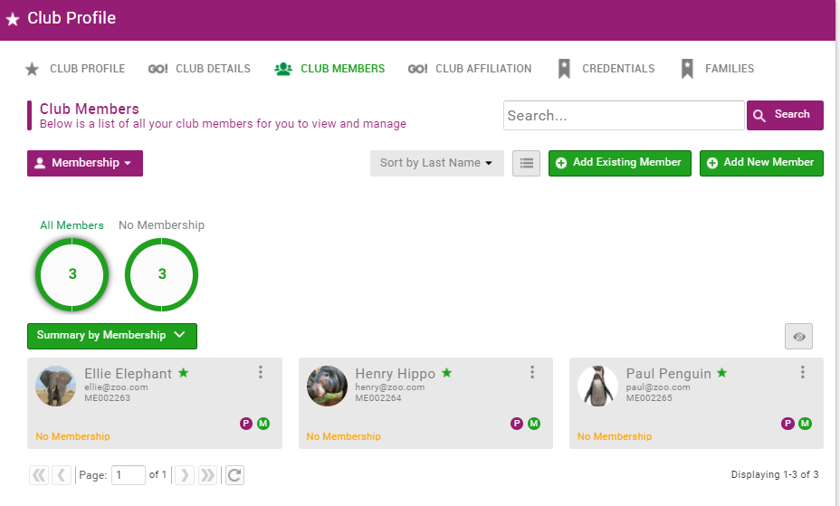

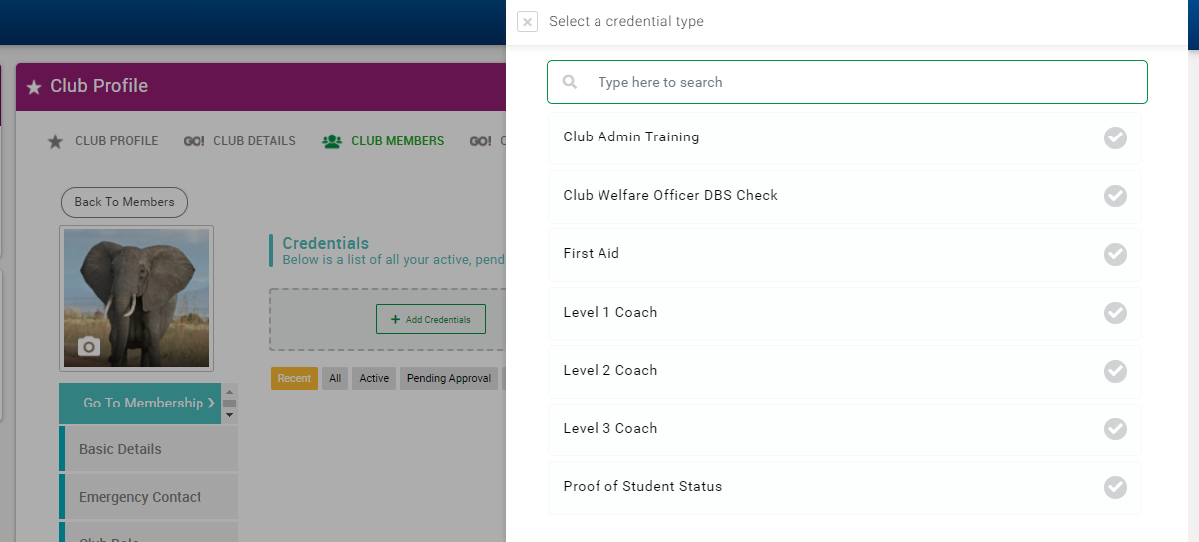
CLUB MEMBERS’ CREDENTIALS
CLUB MEMBERS’ CREDENTIALS
4
Click on the member’s name.
1
1
2
2
Click on credentials
3
Click on
4
Select the credential you want to add to a member and fill in the relevant details.
Note that for coaching and helming credentials the club member must also have an active BDA membership. This is to ensure that insurance is valid for that credential. For coaches above level 2 a Club Welfare Officer DBS check is required. You will not be able to add credentials without these being in place.
4
3

Slide 15
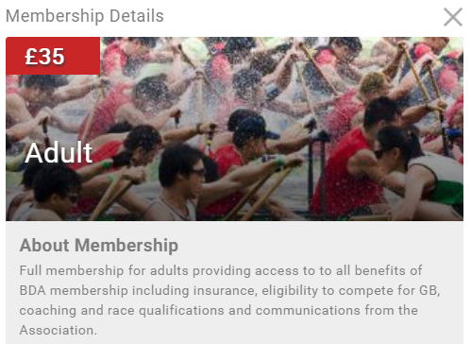
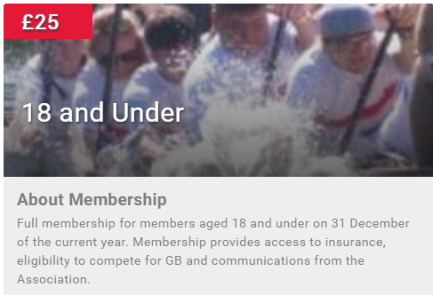
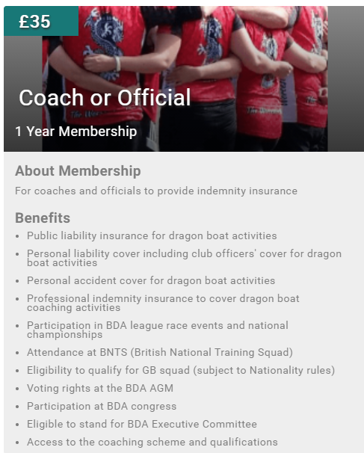
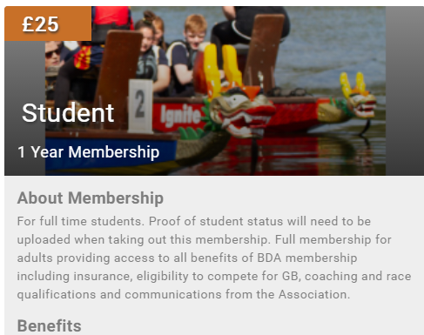
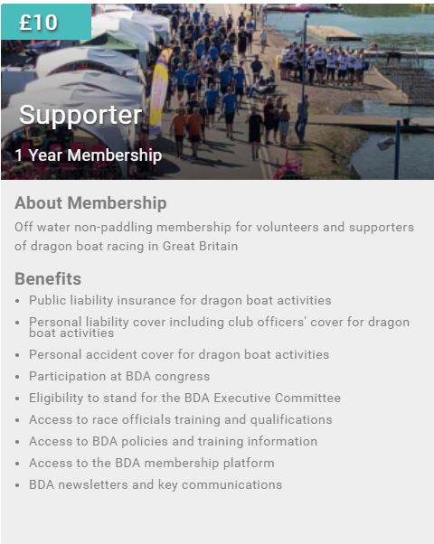
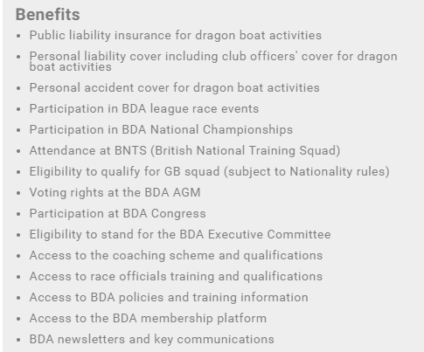
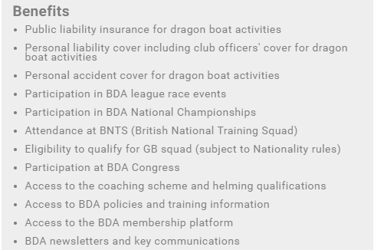
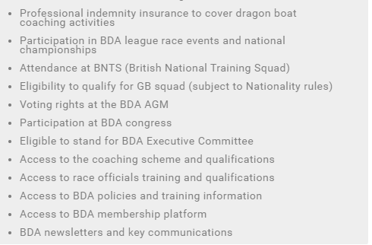
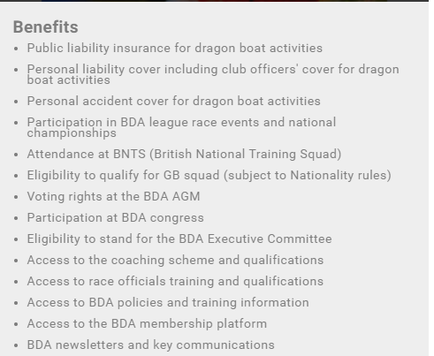
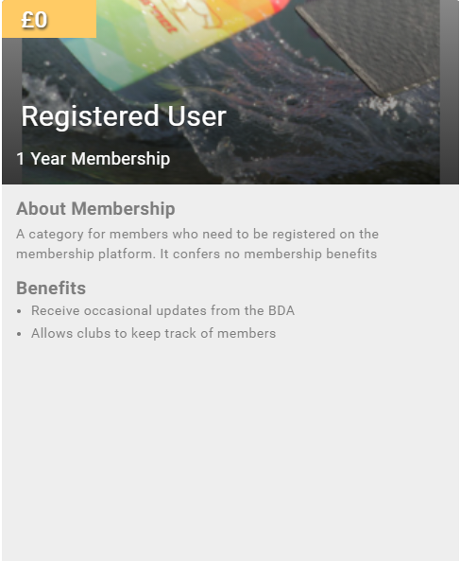
BDA INDIVIDUAL MEMBERSHIP TYPES
Notes:
This is just for information at this stage.

Slide 16
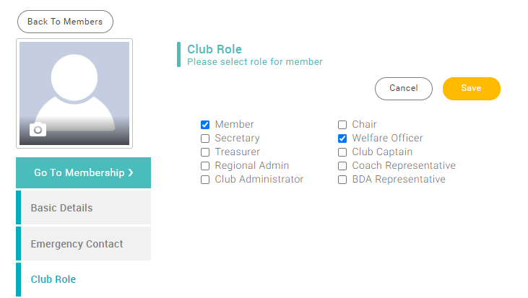
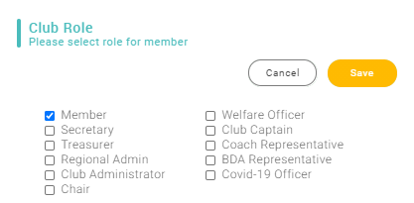
CLUB ROLES
1
2
CLUB ROLES
1
Click on member
2
Click on Club Role
3
Select Role(s)
Access Rights
Club Administrator – this role has permission to see and edit all club members’ details. We advise that at least two people in your club have this role. This role will receive all correspondence to the club from the BDA.
Other Roles - have no special access rights, but will be used for BDA communications, eg when the BDA wants to contact all club welfare officers.
Regional Admin is not used at present.
Covid-19 Officer – required for a club to return to training post Covid
3

Slide 17
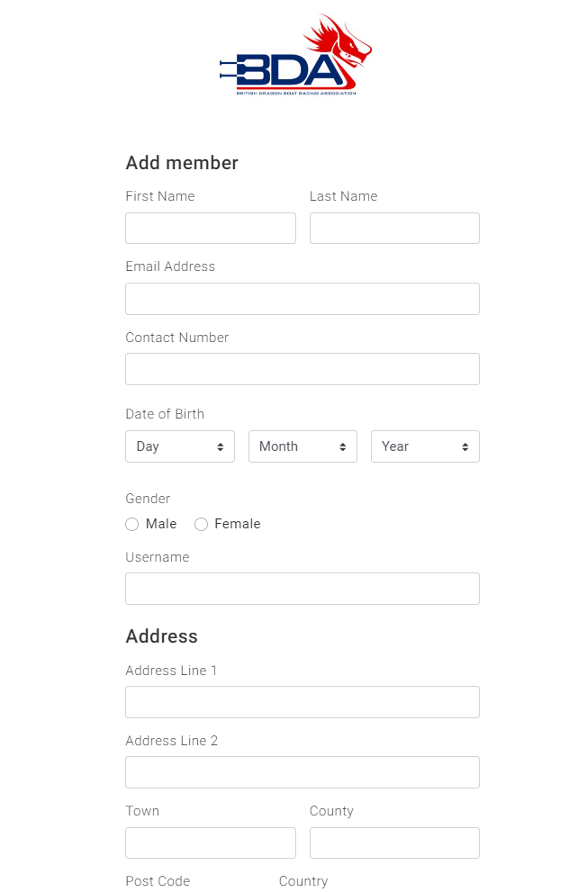
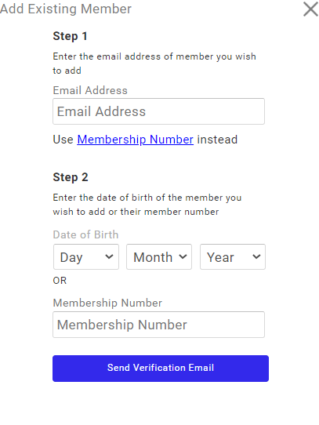
ADD A CLUB MEMBER
ADD A CLUB MEMBER
1
Add a member who is already registered on the platform
Click to filter
2
Add a member who is not already registered on the platform
1
2
Adding Club Members
Adding members who are already on the platform requires you to know certain details. If you don’t know these details you will need to ask the member to either give you the details or add themselves to your club.
To add a member who has not already registered you will need to know their personal details and have their permission to add them. It may be easier to ask them to register themselves.

Slide 18
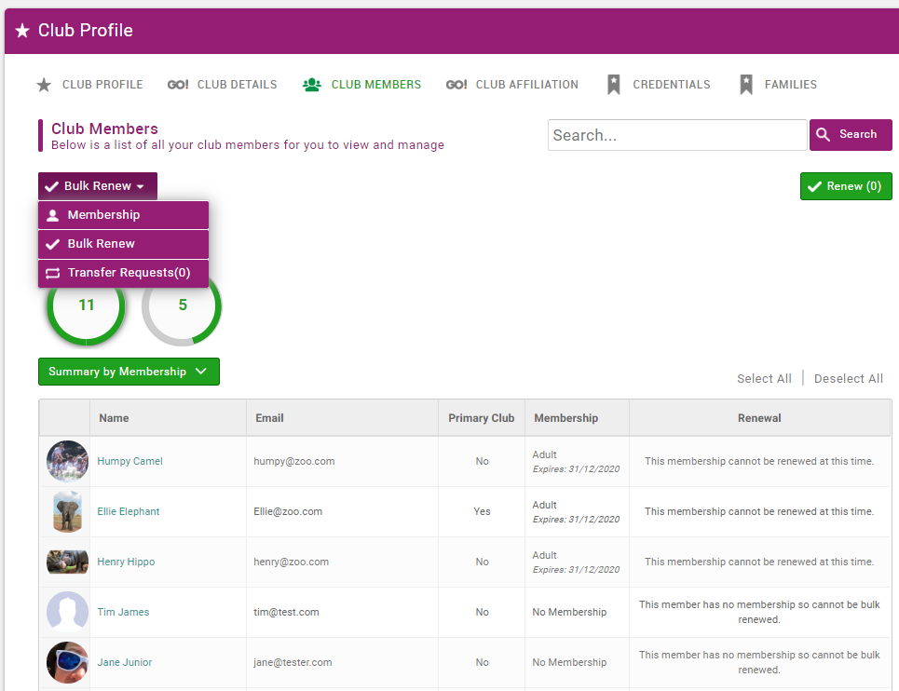
BULK RENEW MEMBERS
BULK RENEW BDA MEMBERSHIPS
1
You can renew club members’ BDA memberships in one step by selecting Bulk Renew
1
2
You will then be able to select which members you want to renew.
Bulk Renew
To be able to use bulk renew members must have already had a membership, you can not use it to take out new memberships.
Memberships become due for renewal 30 days ahead of expiry.

Slide 19
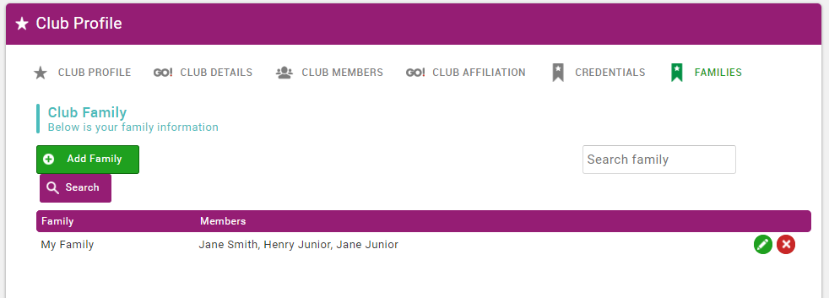

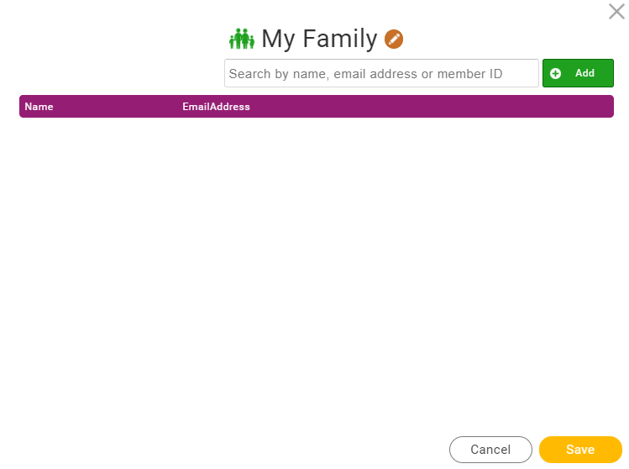
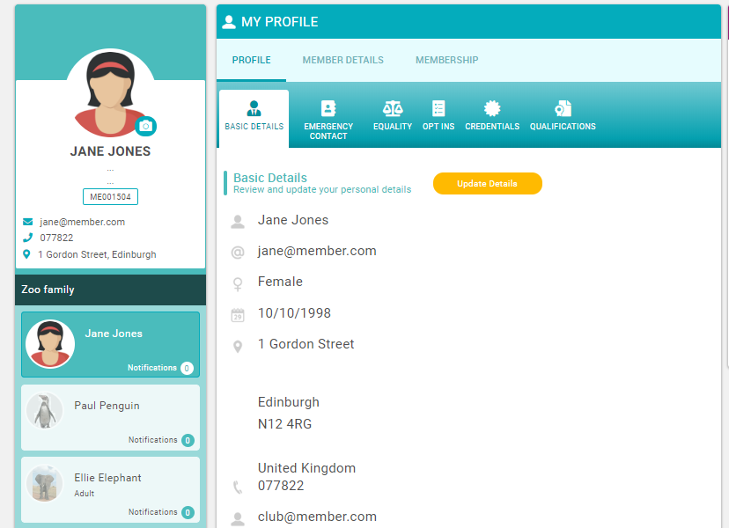
FAMILIES
Click to add a family
1
FAMILIES
1
Family menu
2
2
Add a new family
3
3
Edit or delete a family
4
You will see your family members on your profile. Click to edit.
Families
Families can administer the accounts of anyone else in their family. It can be used for parents or partners to take out memberships on behalf of someone in their family.
To add someone to a family they must be registered on the platform and in your club.
Click search to find an existing member to add to the family
4
Add or delete a family member

Slide 20
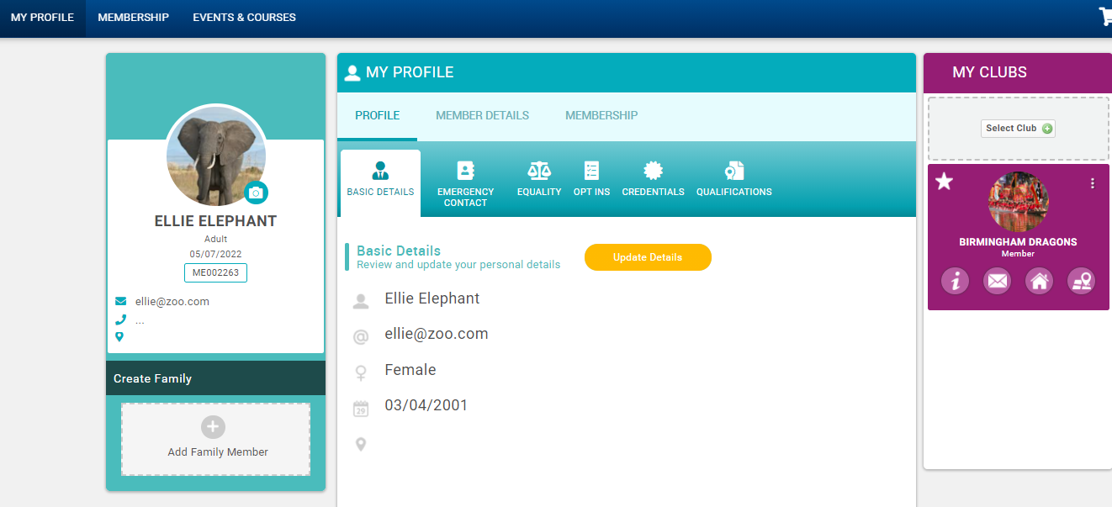
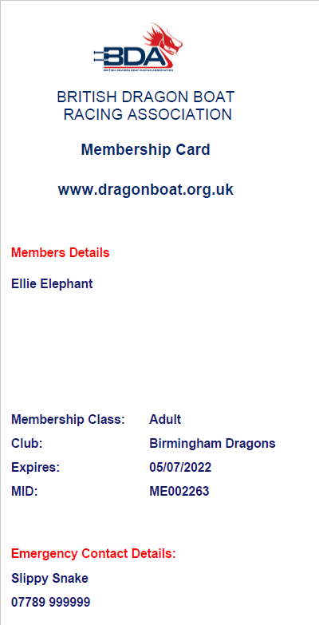
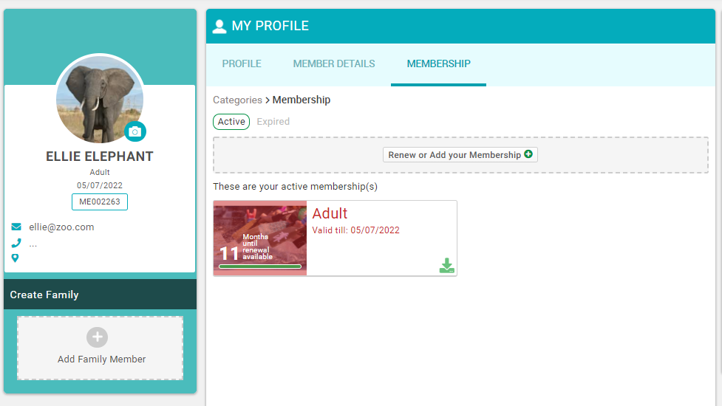
DOWNLOAD MEMBERSHIP CARD
1
DOWNLOAD MEMBERSHIP CARD
1
Click on Membership
2
Click on in the Membership Box
3
A PDF version will download
3
2

Slide 21
DBS Certificates
WHEN SHOULD I APPLY FOR A DBS CERTIFICATE?
This page provides only a very high level summary of the requirements. For more information please visit the BDA Safeguarding page
Do you coach or supervise juniors (U18) in your clubs?
Do you do this
more than 3 times in a month
overnight between 2am and 6am?
DBS Enhanced check for the “Child workforce” including a check on the children’s barred list
Yes
Yes
No
DBS Enhanced check for the “Child workforce” without a check on the children’s barred list
No
Do you supervise adults who are receiving a health or social care service?
Do you do this
Once a week
more than 4 times in a month
overnight between 2am and 6am?
DBS Enhanced check for the “Adult workforce” without a check on the adult’s barred list
Yes
Yes
No
You do not require a DBS certificate, but everyone is entitled to a basic check if the club considers it important. You still require a club welfare officer check for Level 2 and above qualifications (see next page)
Notes:
For further information please see
https://assets.publishing.service.gov.uk/government/uploads/system/uploads/attachment_data/file/739154/Regulated_Activity_with_Children_in_England.pdf
https://assets.publishing.service.gov.uk/government/uploads/system/uploads/attachment_data/file/758275/ENGLISH_-_DBS_Checks_in_Sports_-_Working_with_Adults.pdf

Slide 22
DBS Certificates
CWO applies for DBS check. Member receives certificate
CLUB WELFARE OFFICER’S CHECK
CWO checks certificate in accordance with BDA Safeguarding Policy
CWO fills in a Club Welfare Officer’s Check
To download right click on form and select Adobe Document Object – Open
Or copy and paste the link below into your web browser:
https://bda.azolve.com/WidgetService.mvc/Download?file=~%2FStore%2F%2FRepository%2F26%2F105877%2F154%2FWelfare%20officer%20check%20V2.pdf
Email check to member, and BDA dbs_checks@thebda.org.uk
To go with the new BDA Digital Platform there is a new process for checking and recording DBS certificates. We do not want people to upload their DBS certificates as this may include information that should rightly remain confidential. Currently, the club welfare officer (CWO) is responsible for checking the certificates and we want to keep this process in place. However, to ensure this check is recorded we are now asking for the CWO to provide a written check to confirm they have seen, checked and are happy with the certificate. This process is set out on the slide. If you do not require a DBS certificate (see previous slide) please still fill out this form explaining why it is not required
Or Click on this link then select Documents > Club Welfare Officer DBS Check
Member adds to profile on digital platform

Slide 23
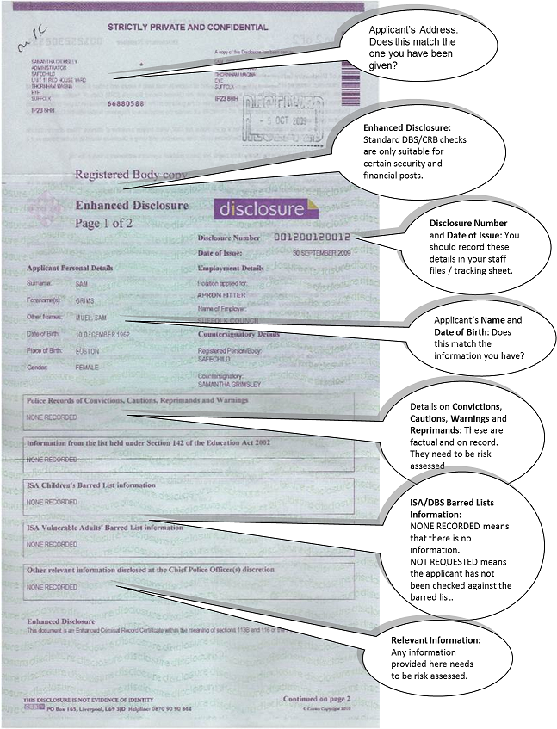
DBS Certificates
HOW TO CHECK THE CERTIFICATE
Notes:
For further information please see
https://assets.publishing.service.gov.uk/government/uploads/system/uploads/attachment_data/file/739154/Regulated_Activity_with_Children_in_England.pdf
https://assets.publishing.service.gov.uk/government/uploads/system/uploads/attachment_data/file/758275/ENGLISH_-_DBS_Checks_in_Sports_-_Working_with_Adults.pdf

Slide 24
EVENTS ENTRY CHECK
When you submit your entry
Event Paperwork
1
2
3
4
Create or modify your Team
Enter the Event
Create a Crew List
Submit your Crew List
Later
You don’t need to know who is paddling to do this, just which crews (teams) you will enter.
Each crew (first, second etc) needs a separate entry into each class (open, women, mixed)
Each crew (first, second etc) needs a separate crew list for each class (open, women, mixed)
Either hard copy or by email.
Think ahead of the event……..
Anyone who might be paddling, helming or drumming needs to be registered on the platform and a member of your club. They can do this anytime in advance and it’s worth getting everyone on just in case.
Everyone must either have BDA membership (adult, student, U18 or coach/official) or pay for a Day Ticket (registered user or supporter) . BDA membership can be done anytime. Day Tickets should be purchased in advance on behalf of non-members from the Event page of the platform. The receipt for day members must be submitted with the crew list.
If you are “borrowing” paddlers from another club for a race event they need to be attached to your club to allow you to put them on the crew list. Doing this well in advance will prevent a last minute panic when you come to do the crew list. Easiest to ask them to do it themselves.

Slide 25
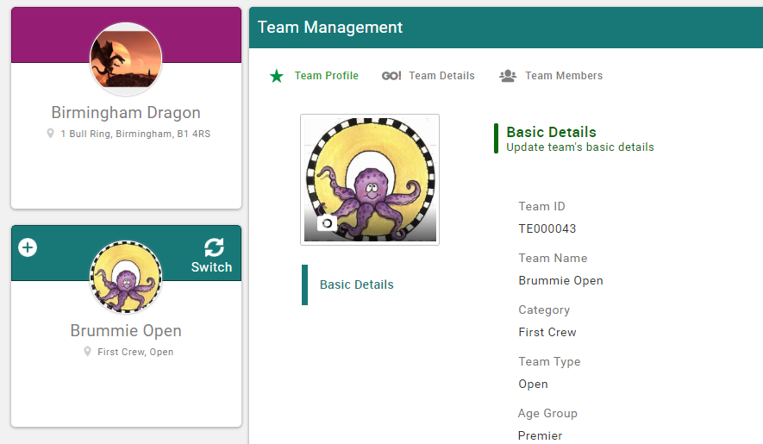


TEAM MANAGEMENT
TEAM MANAGEMENT
1
Select Team Profiles to access page
3
2
Click to add a new team
2
Enter the details of the team
3
Team Management
Team management is for you to produce a Crew List for an event. It’s not perfect, but it’s better than it was before!
Please only set-up the teams you need. There is no way for a club to delete a team, though a BDA Admin can do it for you. You should re-use the teams for each event not set up new ones. You will need one team for each class you enter, eg open, mixed or women. If you have a second crew you will need one team for each class entered as well. For the Nationals you will need to separate them by days. At the end of the year we will delete all teams to let you start afresh. See next slide for example.
Click here to
Add a New Team
Click here to
Switch Between Teams
1

Slide 26
TYPICAL TEAM SET-UP
LEAGUE RACE ONE
Events to be entered
Open
Women
Set up both crews as new crews
LEAGUE RACE 2
Events to be entered
Mixed
Women
Rename “Open” as “Mixed”
Re-use the women’s crew
LEAGUE RACE 3
Events to be entered
Mixed A
Mixed B
Women
Re-name “Mixed” crews as Mixed A
Set up a new crew as Mixed B
Re-use the “Women”
EVENT FOUR
Events to be entered
Open
Women
Re-name the Mixed A as Open
Re-use the women’s crew
Remove all paddlers from Mixed B
NATIONALS
Events to be entered
Open 500m and 200m
Mixed 500m and 200m
Women 500m and 200m
Senior
Re-name “Open” as “Open 500m”
Re-name “Women” as “Women 500m”
Re-name “Mixed B” as “Open 200m”
Set up new crews for the remainder
KEY RULES
Don’t add a new team until you have re-used all the ones you already have set up
If you have a team you are not entering then remove all the paddlers before doing your crew sheet

Slide 27
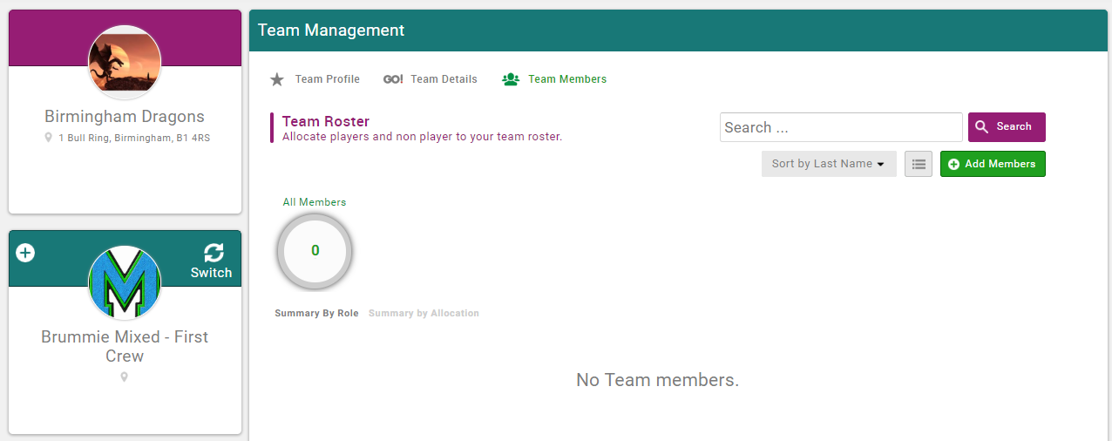
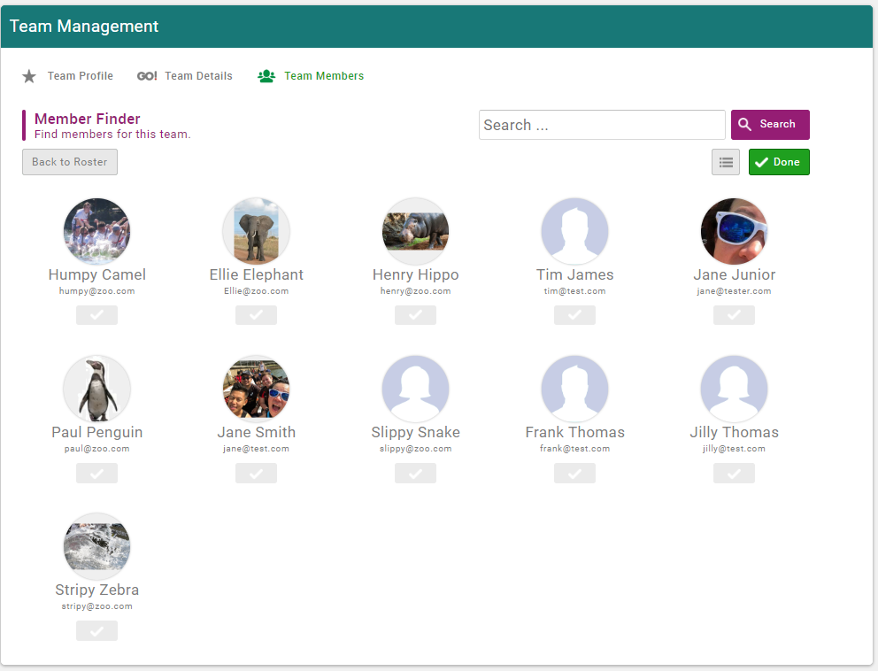
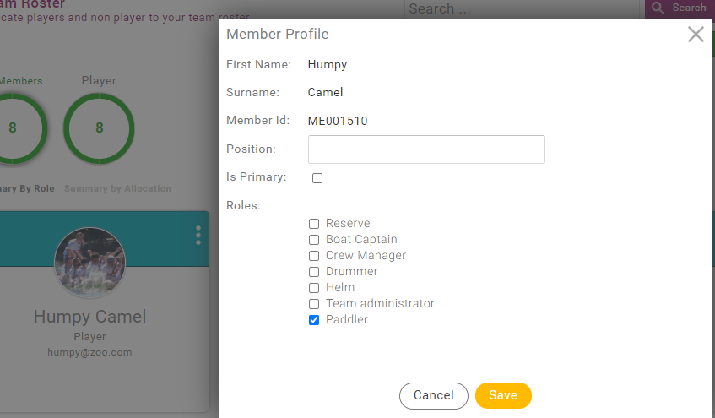
CREW LISTS
2
CREW LISTS
1
Select the team you want to make the crew list for
3
2
Select Team Members
1
3
Click Add Members
4
Select your members. Click Done.
Select the team you want to make the crew list for
5
Click on the next to each member, view profile and select their role for that team
4
Crew Lists
Note that anyone you select as a Team Administrator has access to select and change a team. Make sure you identify helms and drummers.
Ensure that all your selected paddlers and helms are members of the BDA. You must take out day membership if they are not.
5

Slide 28
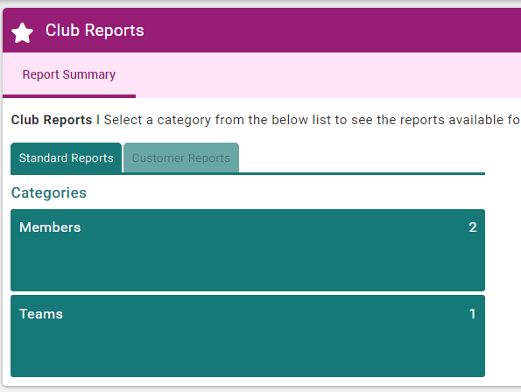
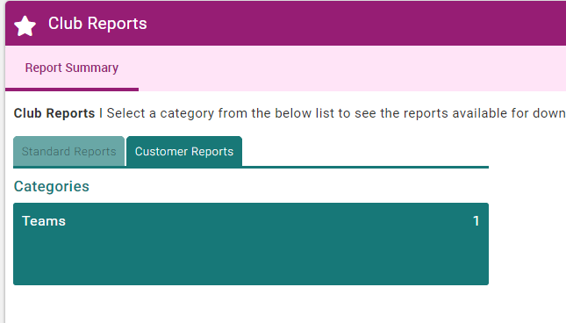
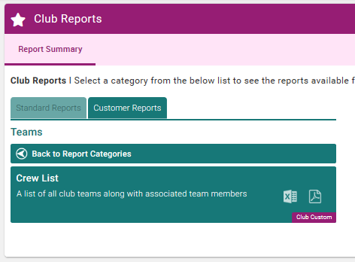
CREATION OF CREW LISTS
1
2
CREW LISTS
1
Select Club Reports to access page
2
Click Customer Reports
3
Click on Teams
4
Click on either Excel or PDF version to download
Crew Lists
All your teams will download onto a single crew list. This is fine, they will be sorted by team.
4
3

Slide 29
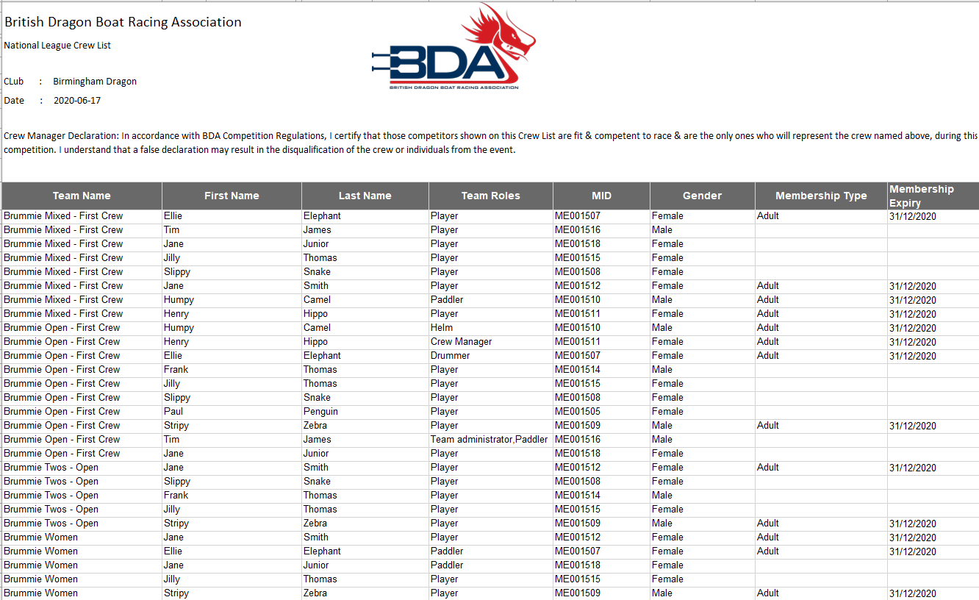
CREATION OF CREW LISTS
Notes:
Once you are happy with the teams (crews) you have selected you can produce a crew list. Go to Club Reports, Customer Reports, Team and download into Excel or pdf.
All your teams will download onto a single crew list. This is fine, they will be sorted by team. This is the list that needs to be printed and submitted on the day.

Slide 30
SUBMISSION OF CREW LISTS
THINGS TO NOTE ABOUT CREW LISTS
Crew lists cannot be submitted online or by email; you need to download and print your crew list and hand it in on the day.
Ensure that all your selected paddlers and helms are members of the BDA (adult, U18, student or coach/official). You must purchase Day Tickets on behalf of anyone who does not have these classes of membership including registered users and supporters (if they are paddling or helming). You/they need to register on the platform to enable you to buy the Day Ticket for them. Please do not leave Day Tickets until the day of the race as the officials will not have the facility to do this for you.
We know that if you download the Excel version you can change the membership status, so we will be doing random checks - don’t even consider it. The officials will have a separately generated list.
The system will not stop you adding a member to more than one crew, so make sure you haven’t used the same members in first and second crews or mixed and open crews (this is double-rostering and is not allowed).

Slide 31
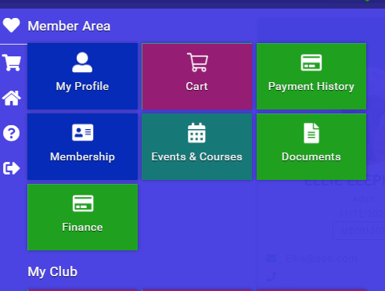
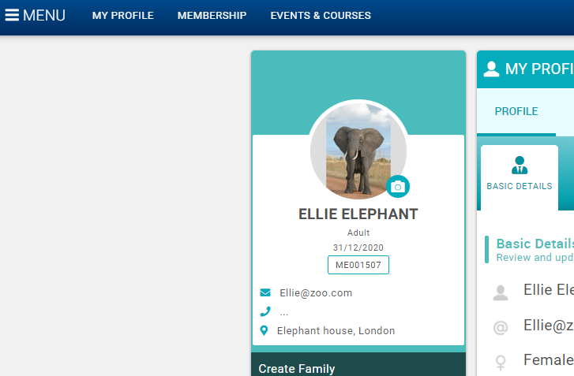
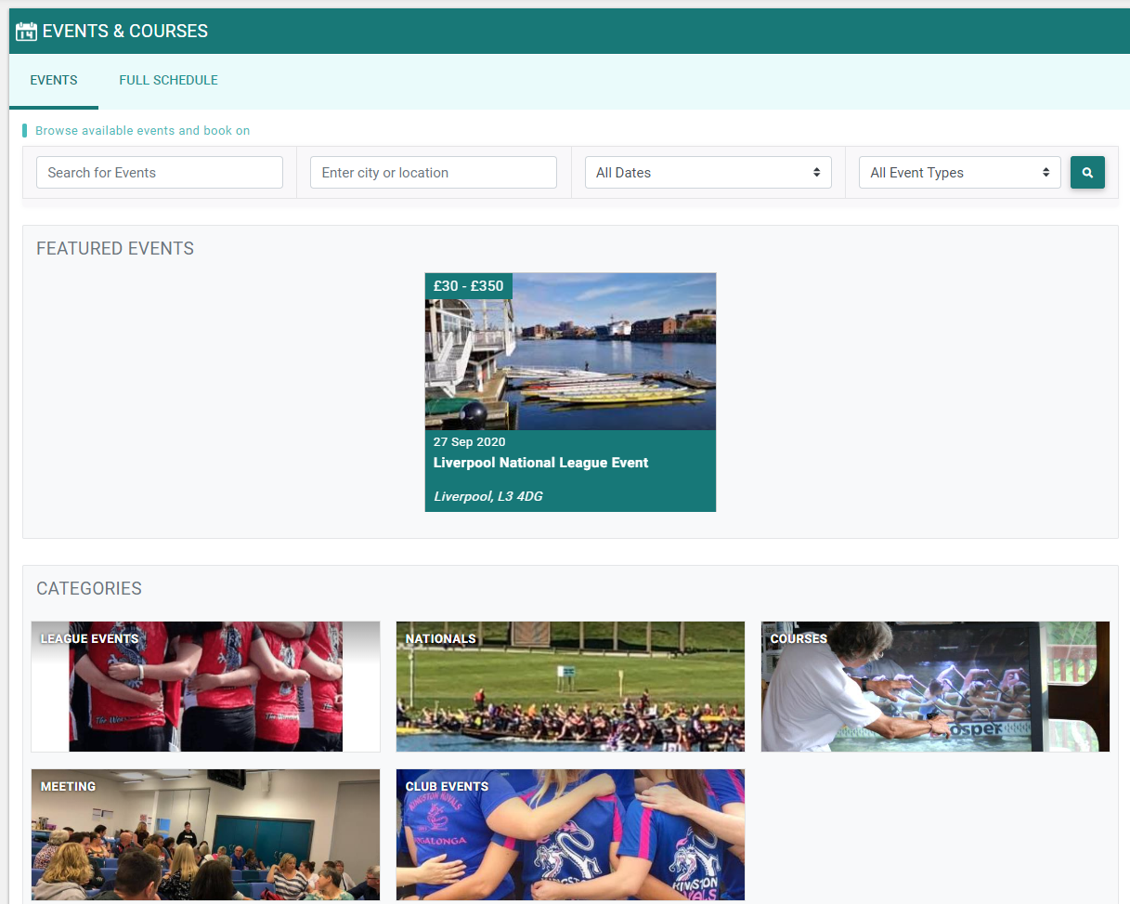
EVENTS
EVENTS
1
1
Click on Events & Courses to access
2
Select the Event you want to enter. If you don’t see it in Featured Events click on the Category below to find it.
2

Slide 32

ENTER A LEAGUE EVENT
EVENTS
3
1
Read the event information
Any queries should be sent to the Event Organiser
2
3
Select club booking to book
1
2

Slide 33

ENTER A LEAGUE EVENT
4
EVENTS
1
1
Select a class you want to enter
Check the description for each entry type to make sure you qualify
2
2
3
Select the team you want to enter
4
Click confirm booking to check out and pay
3
Tick the box to select the team(s) you want to enter in the event
Event Bookings
Ensure you have set up your team before you try and book an event.
Please read the descriptions for each entry type carefully and ensure that your club and crew have the correct membership.
You can book all your teams at the same time or separately.

Slide 34
DAY TICKETS FOR A LEAGUE EVENT
4
EVENTS
1
1
Select a class you want to enter
Check the description for each entry type to make sure you qualify
2
2
3
Select the team you want to enter
4
Click confirm booking to check out and pay
3
Tick the box to select the team(s) you want to enter in the event
Event Bookings
Ensure you have set up your team before you try and book an event.
Please read the descriptions for each entry type carefully and ensure that your club and crew have the correct membership.
You can book all your teams at the same time or separately.

Slide 35

PAYMENTS
PAYMENT
2
Check the summary
1
2
You can pay by direct debit or with a card
1

Slide 36

REPORTS
1
2
CLUB REPORTS
1
Select Club Reports
2
Click Members
3
Click on the Report you want. The report downloads to your Downloads folder.
Other Reports
If there is any other information you require based on information held in the system it may be possible for the BDA to run other reports for you. Please contact us and we’ll try to help.
3

Slide 37


DOCUMENTS
1
BDA DOCUMENTS
1
Select Documents
2
Click on the document you want to download
2
3
Click on the Attachment
Documents
This section holds BDA documents. We will be working to expand this over time. All the Help documents relating to the platform will be stored there.
3

Slide 38
Club
Members
Qualifications and Credentials
Check club affiliation
Check your BDA club membership is showing. Ask us if you think it is not correct.
Please check all members have filled in date of birth
This is really important to ensure that they are offered the correct membership when they renew
Check DBS certificates
All Level 2 Coaches and Club Welfare Officers need Club Welfare Officer check. Add any missing information.
Add other club officers and administrators
We recommend at least two club administrators. They will receive most of the BDA communications replacing the Crews@ address.
Ask all members to fill in profile information
Profile info will help you manage the club particularly safety and medical info.
Check helm and coaching qualifications
Add any missing information. It will be checked by the BDA against existing records and approved.
Add club profile information
Fill in as much info as you can. It will help the BDA to know clubs better and may be used on the BDA club finder later
Chase up registration and encourage joining
If there are members you know have registered or joined but are not showing in your club ask them to log in and add your club to their profile.
Ensure coaches are BDA members
Coaches should be members at all times to provide continuity of personal liability insurance.
CLUB ADMIN PROCESS
Check existing members without email addresses
There are a few members who have not provided email addresses. They need to be chased to do so.

Slide 39
CLUB ADMIN CHECKLIST
Fill in your club profile and club roles
Check all your club members are registered on the system and added to your club whether
they are a BDA member or not. Encourage them to fill in the safety and medical information for you.
Check all your club members’ qualifications and DBS checks are shown
Set-up at least two members of the club as Club Administrator
Check all your coaches are BDA members
Practice setting up a team, selecting your club members and producing a crew list
Brief your club welfare officer on the updated system for DBS Checks
Download a report
Update your membership forms (see next slide)
Check everyone has amended their date of birth. This is important to ensure they are offered the correct
membership next year.

Slide 40
CLUB MEMBERSHIP FORMS
It’s important to the BDA Executive Committee that we know who is a member of our clubs even if they are not BDA members. This is because you as a club are covered by insurance that protects you in the event of a member causing an accident. Additionally, it gives us information that we need as we implement our new strategy and look for ways to grow and improve the sport. We therefore need you to either ask your members to register or to do it for them when they join your club. They do not need to take out BDA membership at this stage.
We recommend that you update your club membership forms to include consent for you to share your members’ data with the BDA on the new platform.
Sharing data with the British Dragonboat Racing Association.
We may share your personal information with the British Dragon Boat Racing Association (BDA) whether you choose to become a BDA member or not. This is to provide insurance for our club activities and to allow them to properly administer the sport. If we share your information the BDA will provide you with access to the digital platform to administer your details. The BDA will contact you to invite you to sign into and update your details. The platform will allow you to set and amend your privacy settings. You can also ask for your account to be deleted should you decide to leave the club.

Slide 41
I STILL NEED HELP!
Contact: ali.marsland@thebda.org.uk
We are looking for club super-admin users around the country, so if think you could help out being a contact for other clubs please let me know and help us continuously improve our sport.

